Slide 1

Acute Stress Reaction vs. Mild Traumatic Brain Injury in Combat: Recognition and Management for Frontline Providers
MAJ Rob Smith-Dvorak, PhD, ABPP…
SERE Psychologist

Slide 2

Why This Matters
Both Acute Stress Reactions and minor TBI are common in combat (blast exposure, high stress)
Symptoms overlap → misdiagnosis leads to:
  Unnecessary evacuation (hurts readiness)
  Missed treatment (risk to soldier + unit).
Providers are often the first and only line of assessment

Slide 3
What is an Acute Stress Reaction?
Short-term psychological reaction to extreme stress/threat
Key features:
Disorientation, impaired attention
Tachycardia, sweating
Emotional lability (panic, freezing, detached affect)
Usually resolves in hours → 72 hrs.
Think of ASR as the nervous system on overload — not brain damage

Slide 4
Question to the group
Has anyone ever seen an acute stress reaction in a combat setting?
How about outside a combat setting?

Slide 5
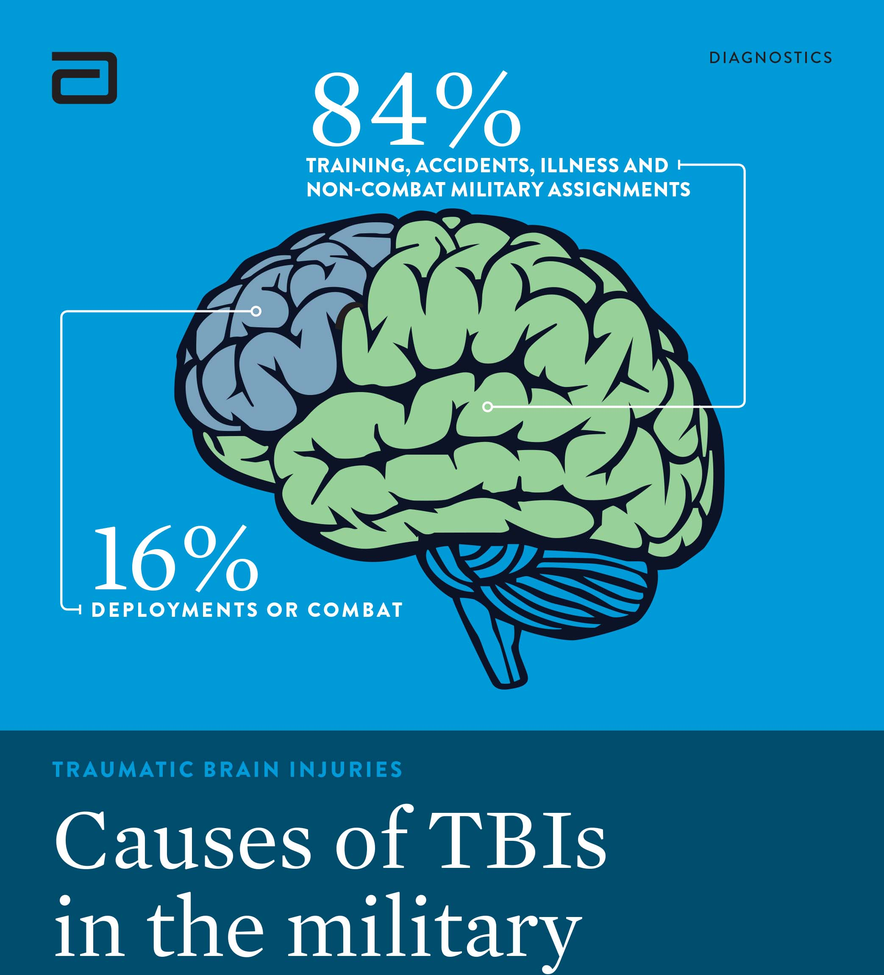
What is mTBI (in a combat context)
Physical injury to the brain from blast, blunt trauma, or acceleration/deceleration.
Key features:
  Brief loss of consciousness (<30 min) or alteration of consciousness
  Post-traumatic amnesia (momentary confusion, can’t recall event)
  Headache, dizziness, balance issues, light/noise sensitivity
  Symptoms can persist beyond 24 hrs.

Slide 6
Question to the group
Has anyone ever seen mTBI in a combat setting?
How about outside a combat setting?

Slide 7
Symptom Overlap
Symptom | ASR | mTBI
Confusion | ✅ | ✅
Memory gaps | ✅ | ✅
Headache | ❌ | ✅
Emotional lability | ✅ | ❌
Nausea/vomiting | ❌ | ✅
Trembling/hyperarousal | ✅ | ❌
Both can look like the soldier is ‘out of it.’ The difference is whether it’s a brain injury or a stress response

Slide 8
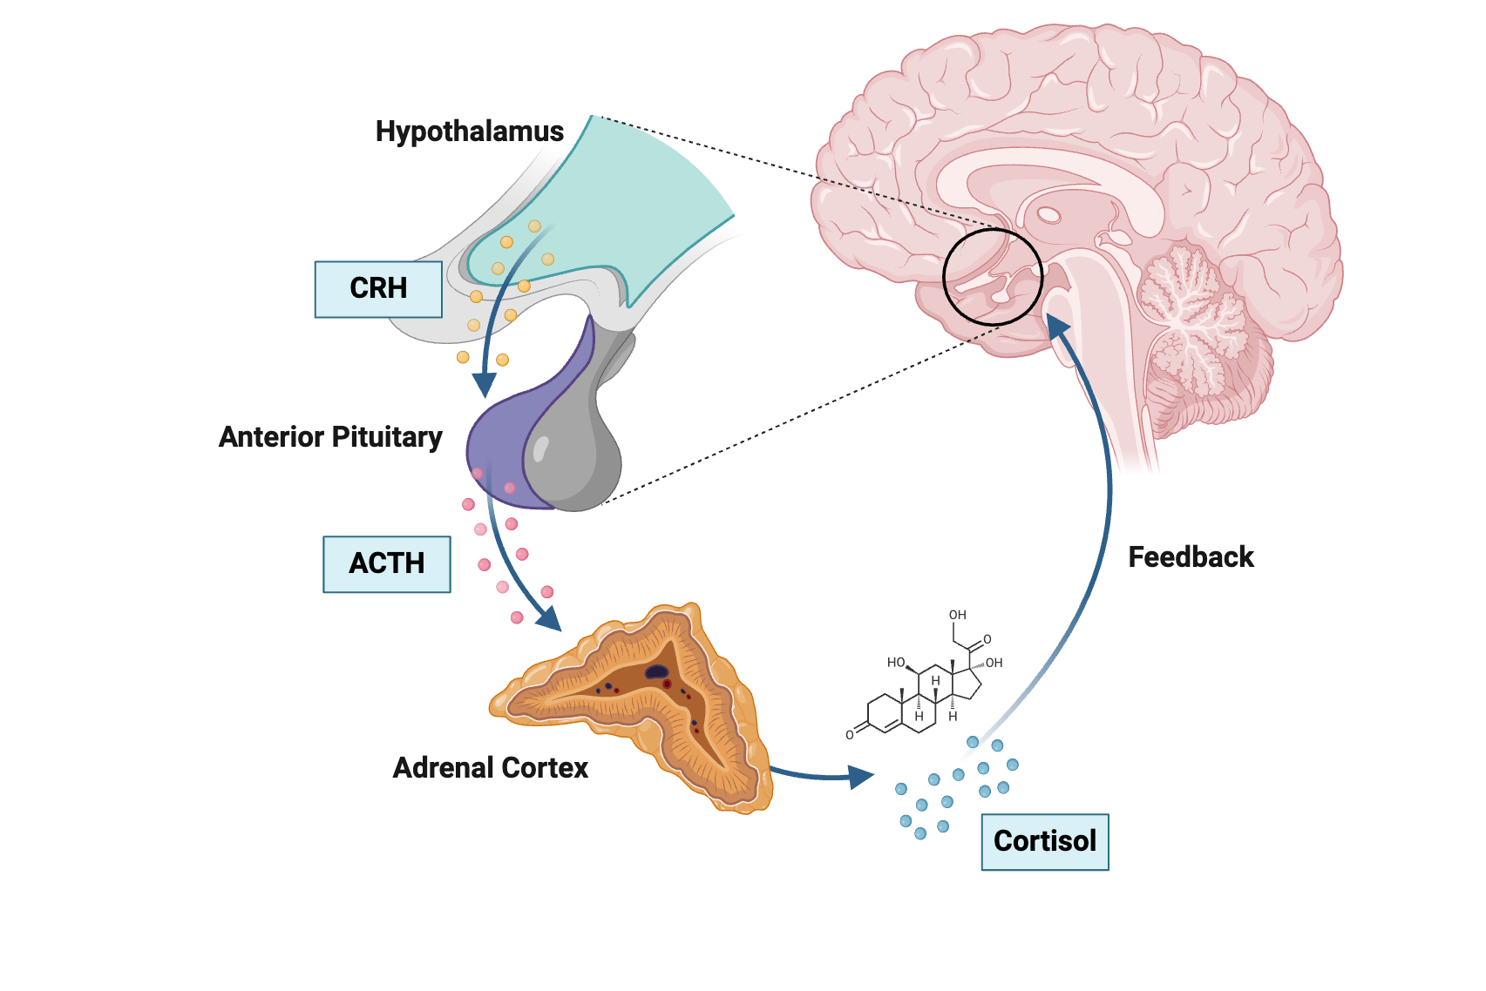
Hypothalamic-Pituitary-Adrenal (HPA) axis Overview
The HPA axis is the central neuroendocrine stress response system:
  Hypothalamus releases corticotropin-releasing hormone (CRH)
  Pituitary releases adrenocorticotropic hormone (ACTH)
  Adrenal cortex releases cortisol
  Cortisol acts on tissues and feeds back to suppress CRH/ACTH
It is tightly linked with the sympathetic nervous system, limbic system (especially amygdala and hippocampus), and immune signaling.

Slide 9
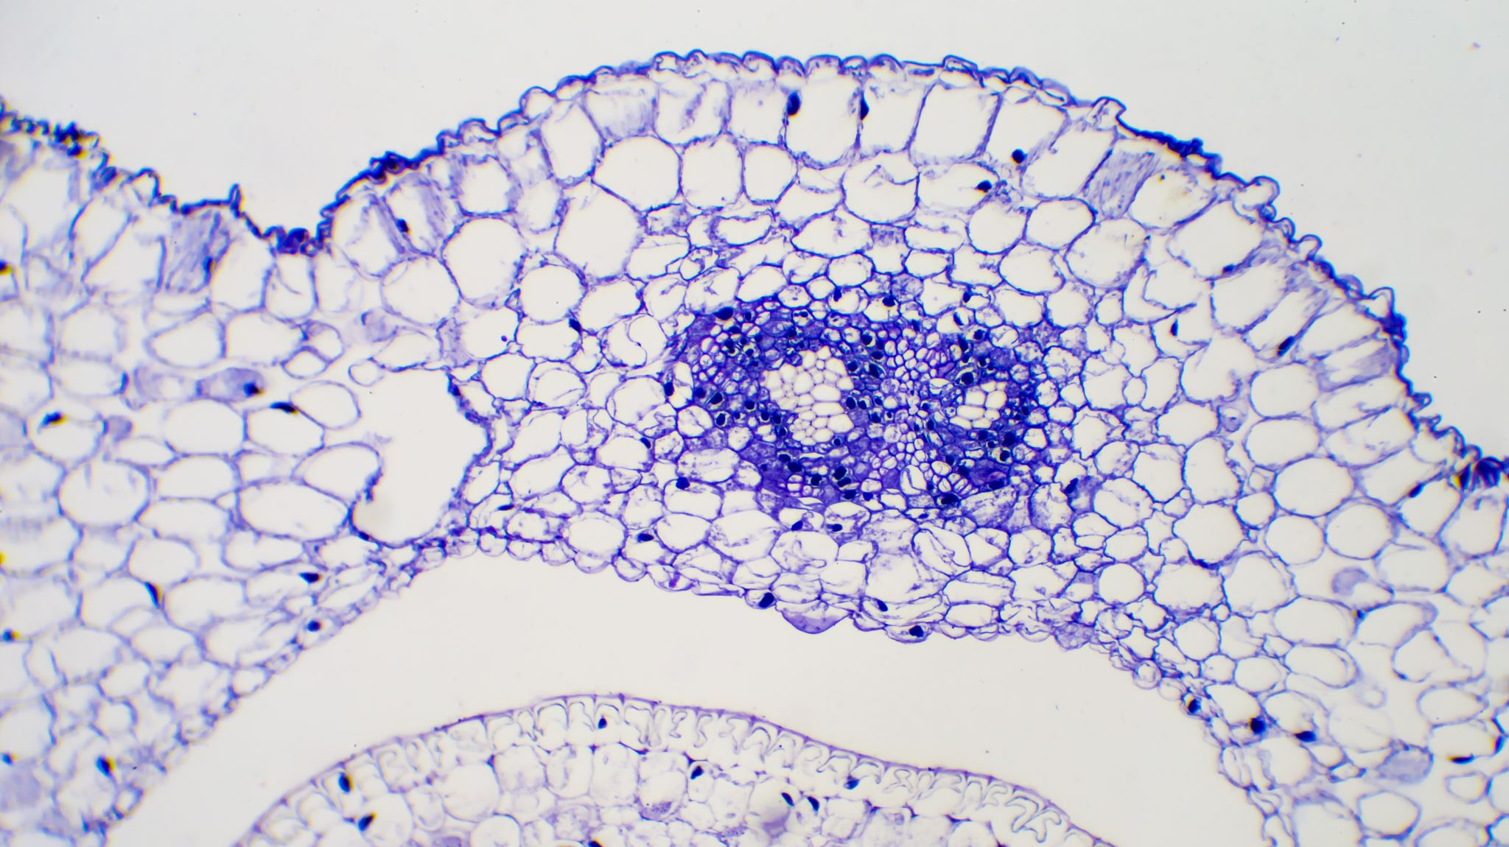
Hypothalamic-Pituitary-Adrenal (HPA) axis Differences across ASR and mTBI
In mild traumatic brain injury (mTBI) and acute stress reaction (ASR), the hypothalamic-pituitary-adrenal (HPA) axis is involved in different ways — both can present with overlapping symptoms (e.g., fatigue, irritability, cognitive changes), but the underlying neuroendocrine patterns diverge because of the nature of the injury vs. stress response.

Slide 10
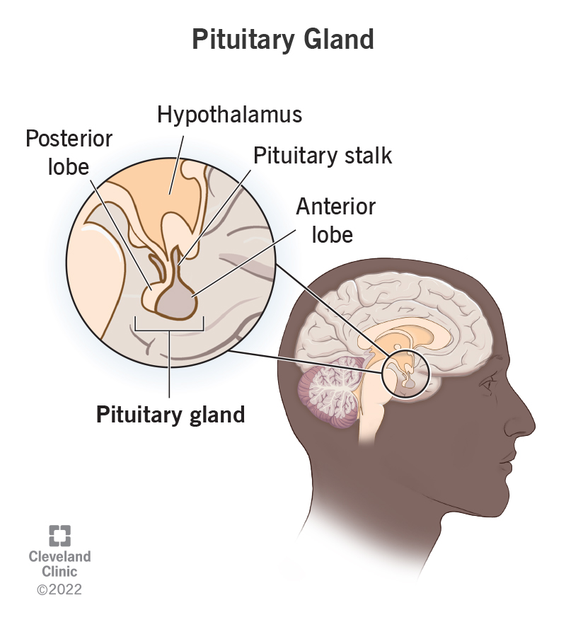
mTBI: HPA Axis Changes
mTBI can cause mechanical and secondary injury to structures regulating the HPA axis (hypothalamus, pituitary stalk, pituitary gland)

Slide 11
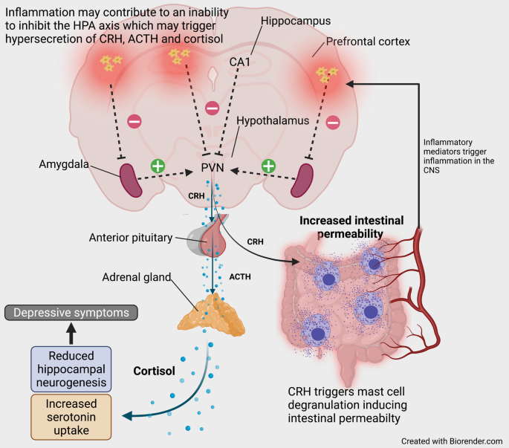
Acute phase HPA-axis dysfunction in mTBI
Acute phase (hours–days):
  Initial surge in cortisol (due to injury and acute stress) is common, but magnitude varies depending on injury severity and individual baseline resilience.
  Neuroinflammation, axonal injury, and microvascular disruption can alter hypothalamic CRH neurons or pituitary ACTH secretion.

Slide 12
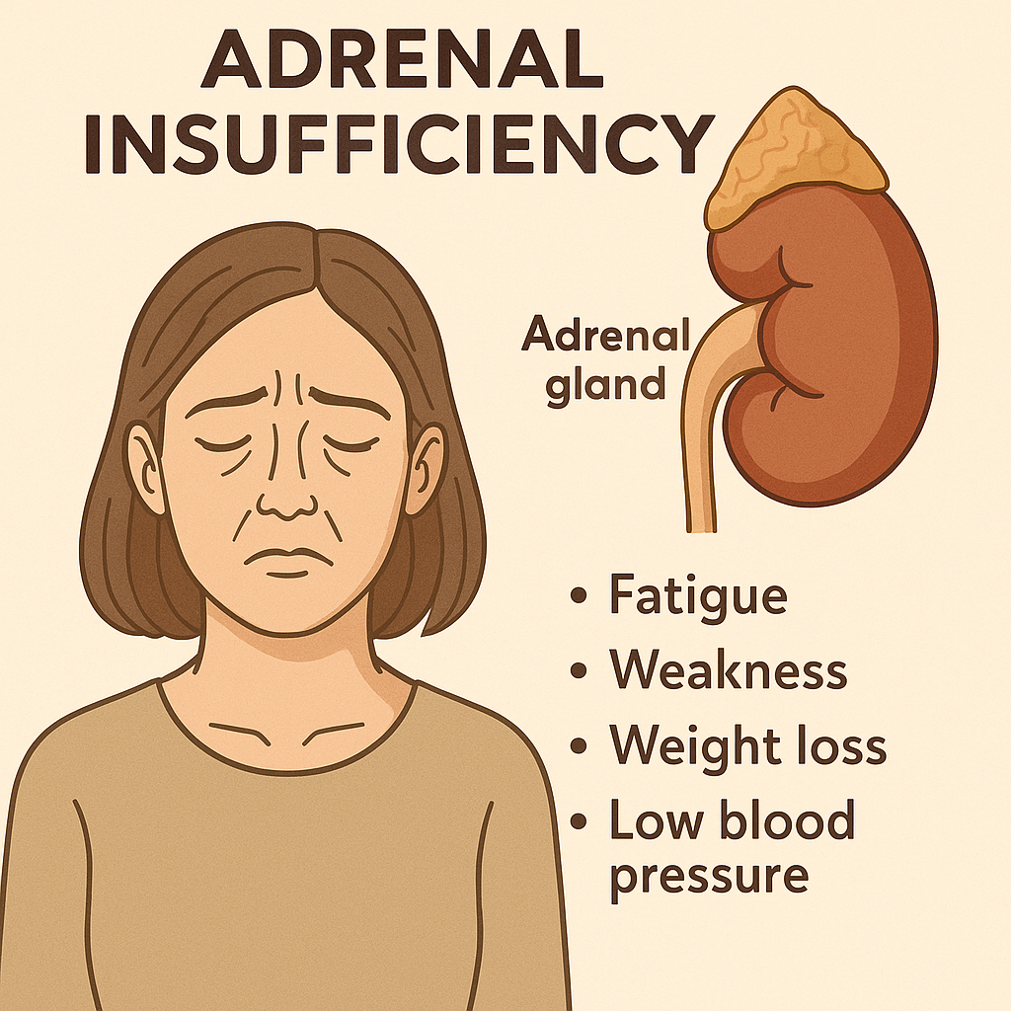
Subacute/chronic phase (weeks–months):
Risk of hypocortisolism due to central adrenal insufficiency (secondary or tertiary)
  Damage to pituitary stalk or hypothalamic CRH release → blunted ACTH → low cortisol.
  This can mimic or exacerbate fatigue, poor concentration, and mood disturbance.
Some patients develop HPA dysregulation with a flattened diurnal cortisol rhythm.

Slide 13
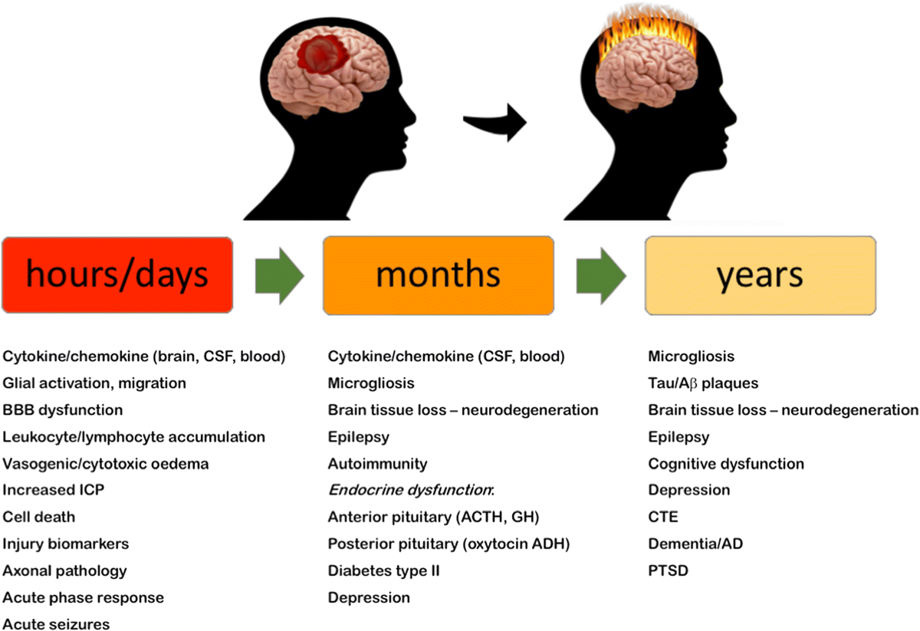
Mechanistic note on the effects of mTBI
mTBI injury can be structural (shearing of axons in hypothalamus/pituitary) and inflammatory (microglial activation, cytokine-mediated signaling altering CRH neurons).
Even without overt pituitary injury, altered feedback loops may cause persistent hypo- or hyperactivation.

Slide 14
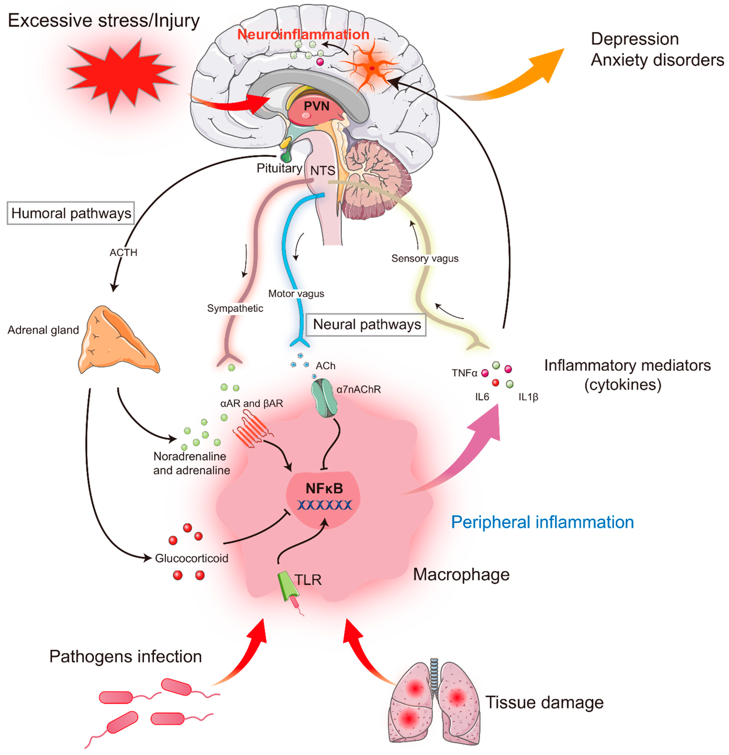
ASR: HPA Axis Changes
ASR is a functional stress response without structural injury
  It’s driven primarily by perceived threat and amygdala–hypothalamus activation

Slide 15
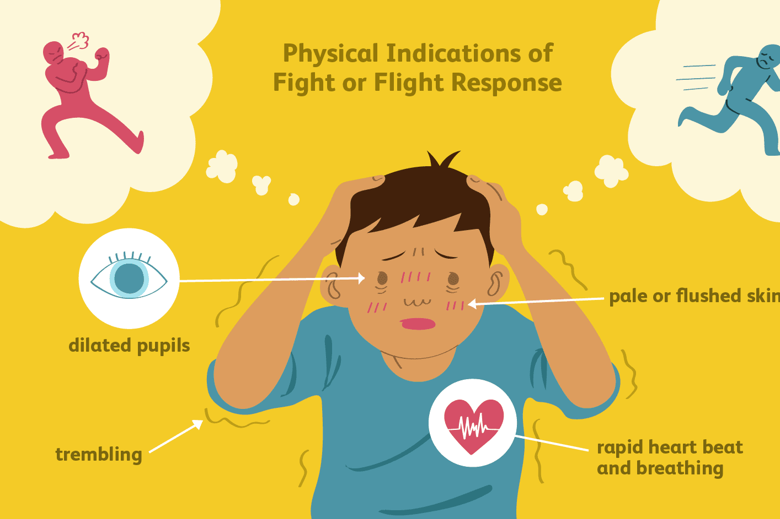
ASR: Immediate phase (seconds–minutes)
Amygdala → hypothalamus → rapid CRH release.
CRH → ACTH → large, rapid cortisol surge.
Parallel activation of sympathetic-adrenomedullary (SAM) system → adrenaline/noradrenaline release.

Slide 16
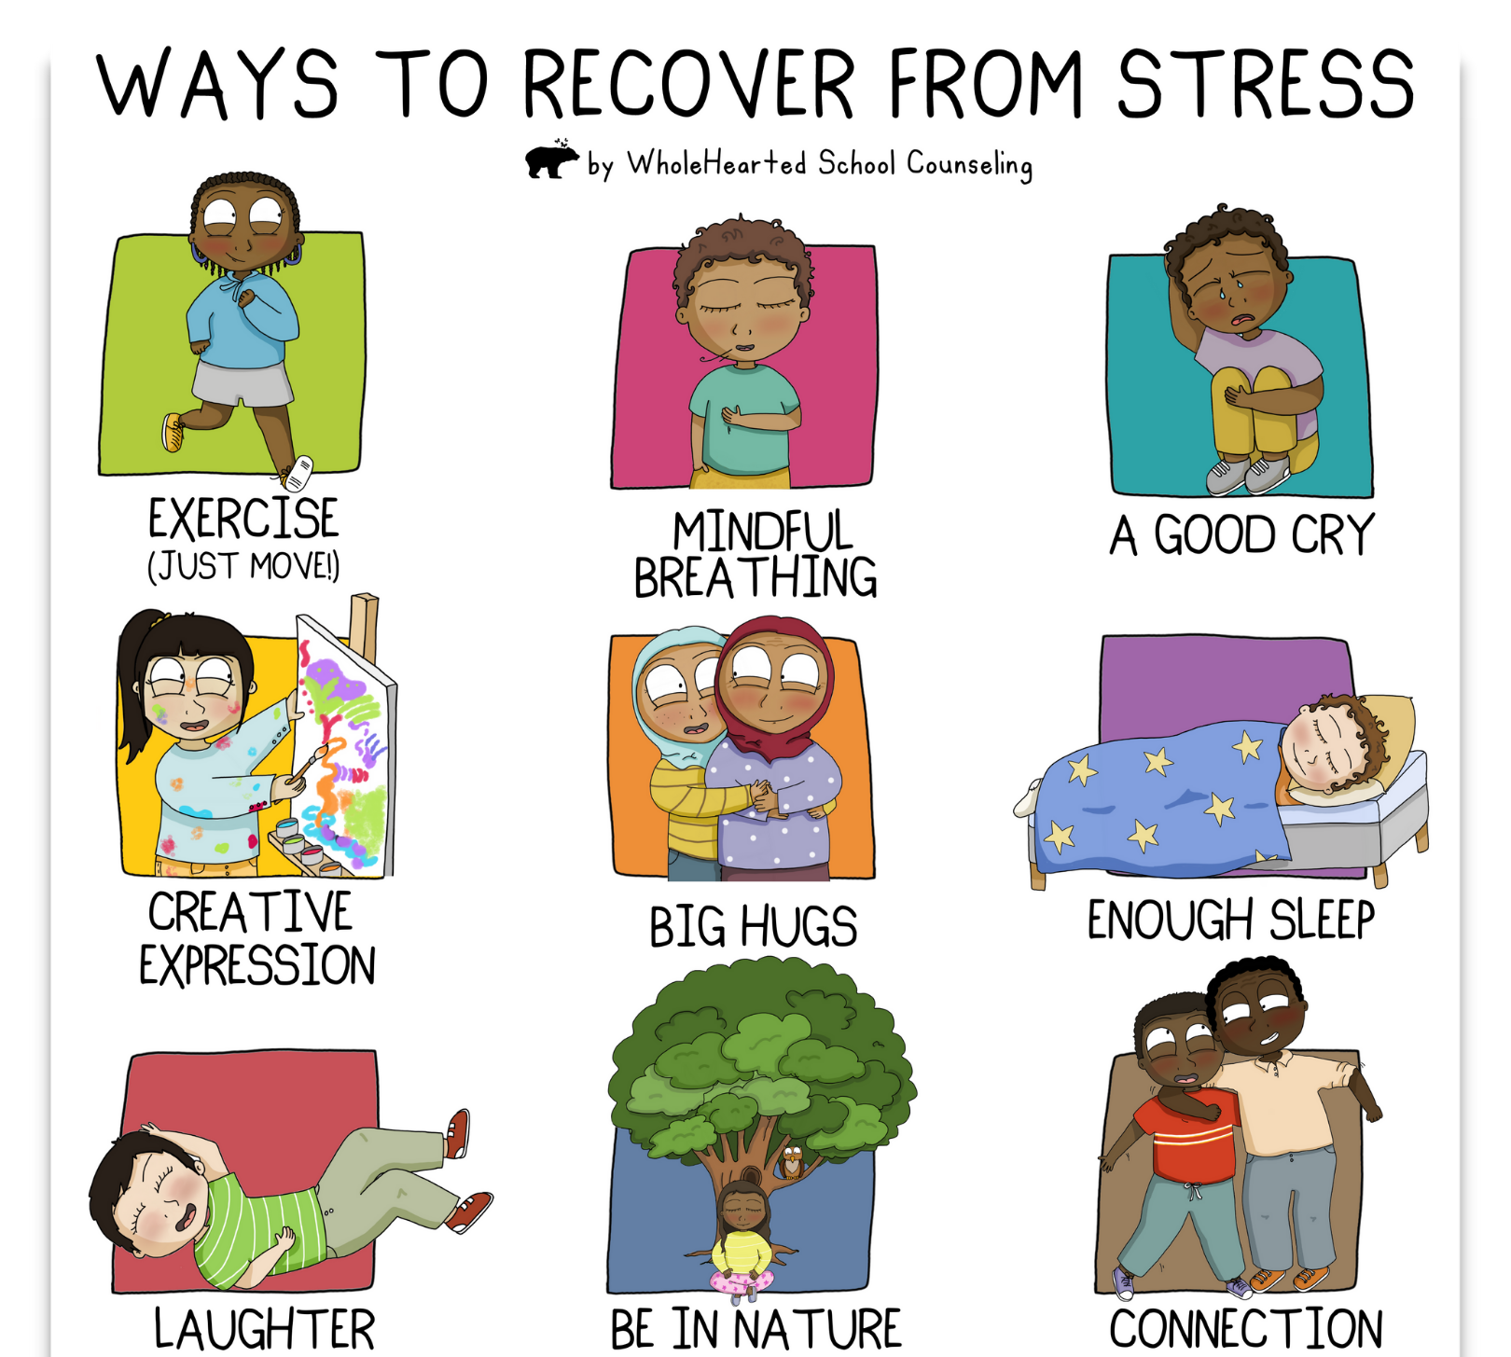
ASR: Short-term phase (minutes–hours)
Elevated cortisol modulates memory formation (esp. consolidation of threat-related memories), suppresses non-essential processes, and mobilizes glucose
If threat resolves and coping is effective, negative feedback restores baseline quickly

Slide 17
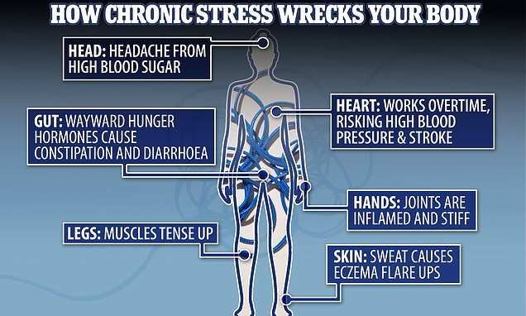
ASR: If stress is prolonged
Sustained high cortisol → hippocampal feedback impairment → possible delayed shut-off, leading to extended hypercortisolemia.
If intense enough, can cause transient blunting of HPA reactivity afterward (seen in some acute trauma studies).

Slide 18
Key Differences: mTBI vs. ASR in the HPA Axis
Feature | mTBI | ASR
Trigger | Mechanical brain injury | Perceived/threat stimulus
Structural involvement | Possible injury to hypothalamus, pituitary, pituitary stalk | None; functional activation
Acute cortisol pattern | May have modest or blunted surge if HPA damaged; or normal/high early | Typically robust surge
Chronic pattern | Risk of hypocortisolism (secondary adrenal insufficiency), flattened diurnal curve | Usually normalizes unless stress is prolonged → risk of hypercortisolism then downregulation
Feedback loop | May be impaired structurally (injury to CRH/ACTH pathways) | May be impaired transiently due to hippocampal feedback inhibition
Associated risks | Pituitary hormone deficiencies, fatigue, cognitive slowing | Anxiety, intrusive memories, hypervigilance

Slide 19
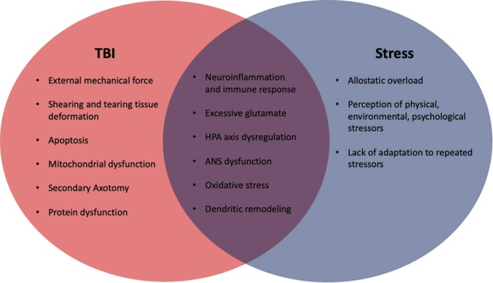
Bottom Line
In mTBI, HPA axis changes are often due to physical disruption or damage to hypothalamic-pituitary structures, potentially leading to chronic hypofunction.
In ASR, the HPA axis is intact and hyperactivated acutely by psychological threat, typically resolving once the stressor ends.
Both conditions can produce overlapping symptoms, but the time course, mechanism, and risk of long-term endocrine dysfunction differ substantially.

Slide 20
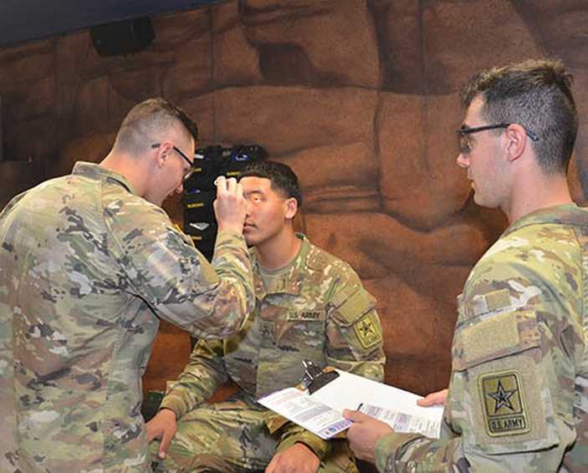
Rapid Field Assessment
MACE 2 (Military Acute Concussion Evaluation) → for suspected mTBI.
ASR indicators → hyperventilation, sobbing, freezing, acute fear.
Quick triage questions:
  Was there blast/head trauma?
  Was there loss of consciousness or amnesia?
  Are symptoms primarily emotional/physiological arousal (ASR) or neurological (mTBI)?

Slide 21

MACE 2 Exam
Purpose:
Standardized tool for rapid assessment of suspected mild TBI in deployed environments.
Supports return-to-duty vs. evacuation decisions.
When to Use:
Any blast exposure, head strike, fall, or sudden acceleration/deceleration.
Any alteration of consciousness (even seconds).

Slide 22

MACE 2 EXAM
Core Components:
  History & Injury Details – Mechanism, LOC, amnesia, immediate symptoms.
  Symptom Checklist – Headache, dizziness, balance, visual changes, nausea
  Neurological Exam – Orientation, balance, coordination, speech.
  Cognitive Testing – Immediate recall, concentration (digits/months backward), delayed recall.
Tip: Use MACE 2 cards in your IFAK or aid station for quick reference

Slide 23

MACE 2 EXAM
Scoring & Interpretation:
  Lower scores = greater impairment.
  Symptom presence does not always equal concussion—consider context.
  Do NOT return to duty if:
    Any LOC
    Symptoms worsen
    Neuro deficits present
Key Points for Providers:
  Takes ~10 minutes.
  Document findings in medical record.
  If concussion suspected → rest, follow CPG for progressive return-to-duty.

Slide 24
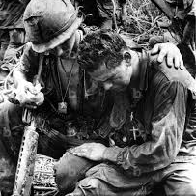
Management of ASR
Grounding techniques:
  slow breathing
  orient to time/place
  simple instructions
Remove briefly from combat, provide reassurance
Usually return-to-duty within hours if recovered
Refer if persistent >72 hrs or functional impairment continues.

Slide 25
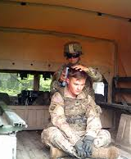
Management of mTBI
Remove from combat environment
Follow Concussion CPG (clinical practice guideline)
  Mandatory 24-hour rest / observation
  No return-to-duty until symptom-free & cleared
  Document in medical record for follow-up

Slide 26
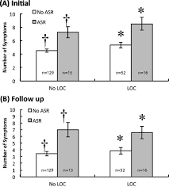
mTBI w and w/o ASR and LOC
LOC did not differ across mTBI/ASR subtypes
Experiencing ASR with mTBI is linked to more symptoms and this persisted 72 hrs later

Slide 27
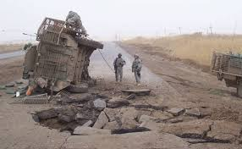
Vignette 1
A 24-year-old infantryman is 20 meters from an IED blast. Squad members report he was knocked to the ground and “looked out of it” for about 30 seconds. He can’t recall the moments right before the explosion and is slow to answer questions. He reports headache and ringing in his ears. Neurological exam shows mild balance instability. Ten minutes later, he is still foggy and forgets details you’ve just told him.

Slide 28
Vignette 1
Key Points:
  Blast + altered consciousness
  Post-traumatic amnesia
  Persistent neurological symptoms (balance, memory)
  Headache

Slide 29
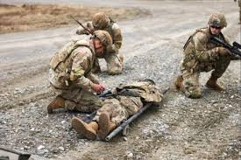
Vignette 2
A 27-year-old medic comes under sudden small-arms fire while tending to a casualty. She freezes, hyperventilates, and is unable to respond to commands for about two minutes. She appears panicked and tearful. Once behind cover and after reassurance from a teammate, she regains composure within 15 minutes. She recalls the entire event and reports no headache, dizziness, or confusion.

Slide 30
Vignette 2
Key Points:
  No direct head injury or blast
  Immediate, intense emotional and physiological arousal (freezing, hyperventilation)
  Full memory of event
  Rapid resolution with reassurance and safety

Slide 31
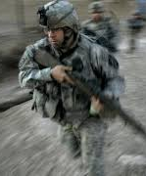
Vignette 3
A 22-year-old rifleman witnesses a close friend hit by small-arms fire during a patrol. He becomes shaky, tearful, and unable to speak for several minutes. He paces and clutches his weapon tightly but does not fire. He responds to grounding techniques and, after 30 minutes, is able to participate in the mission, though he appears subdued. He has no headache, nausea, dizziness, or confusion.

Slide 32
Vignette 3
Key Points:
  No head trauma
  Acute emotional overload linked to witnessing traumatic event
  Rapid improvement with support
  No neurological symptoms

Slide 33
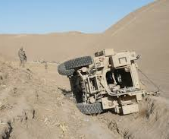
Vignette 4
A 31-year-old truck commander is involved in a MRAP rollover after hitting an obstacle. He was wearing a helmet and seatbelt. On arrival, he’s sitting on the roadside, looking dazed. He repeatedly asks, “What happened?” despite being told multiple times. He complains of nausea and light sensitivity. Pupils are equal and reactive, vitals are stable. Symptoms persist at 20-minute mark.

Slide 34
Vignette 4
Key Points:
  Mechanism with acceleration/deceleration
  Ongoing confusion and repetitive questioning
  Nausea, photophobia
  No rapid return to baseline

Slide 35
Provider Takeaways
Don’t confuse ASR with mTBI — overlap is common, but management differs.
Use MACE 2 for suspected concussion.
ASR = psychological overload, often rapid recovery.
mTBI = brain injury, requires medical management & rest.
Correct triage preserves force + saves lives.

Slide 36

Resources
DoD TBI Clinical Practice Guidelines
Combat & Operational Stress Control (COSC) doctrine
Military Acute Concussion Evaluation (MACE 2) card
Slides: www.robdvorak.net/slides

Slide 37

Questions

